Slide 1
Target Marketing and Strategies
Conventional Marketing

Slide 2
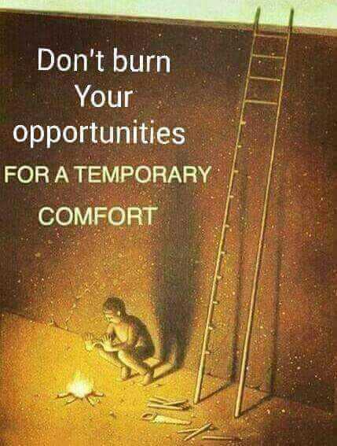

Slide 3
Two Basic Approaches
Market Segmentation Approach
The needs and preferences of the global market are viewed as heterogeneous varying from one group to another.
Total/Mass Market Approach
The needs and preferences of the entire, global market are regarded as relatively homogeneous.

Slide 4
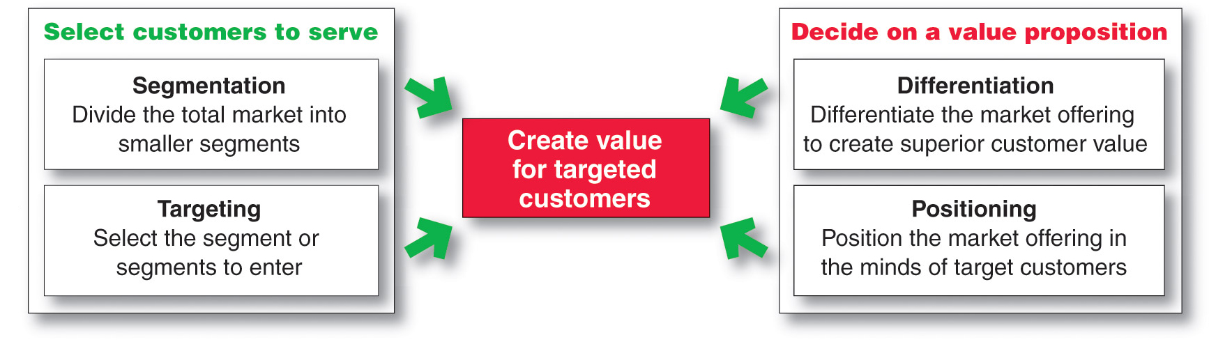
Market Segmentation

Slide 5
Major Steps in Target Marketing
Segmentation
Target Marketing
Market Positioning

Slide 6
Market Segmentation
Dividing a market into distinct groups with distinct needs, characteristics, or behavior who might require separate products or marketing mixes.
Segmentation is breaking down heterogeneous mass market into more homogeneous submarkets
Consumers within segments should respond similarly to particular marketing actions
Consumer response should be different between segments

Slide 7
Target Marketing
The process of evaluating each market segment’s attractiveness and selecting one or more segments to enter.

Slide 8
Market Positioning
Arranging for a product to occupy a clear, distinctive, and desirable place relative to competing products in the mind of target consumers

Slide 9
Segmenting Consumer Markets
Geographic segmentation
Demographic segmentation
Psychographic segmentation
Behavioral segmentation

Slide 10
Geographical Segmentation
Dividing a market into different geographical units such as nation, province, regions, countries, cities or neighborhoods

Slide 11
Geographic Segmentation Variables
World Region or Country
Region
Province
City
Neighborhood
City or Metro Size
Density
Climate

Slide 12
Demographic Segmentation
Dividing the market into groups based on demographic variables such as age, gender, etc.

Slide 13
Demographic Segmentation Variables
Age
Gender
Family size
Family life cycle
Income
Occupation
Education
Religion
Race
Generation
Nationality

Slide 14
Psychographic Segmentation
Dividing a market into different groups based on social class, personality etc.

Slide 15
Psychographic Segmentation Variables
Social class
Lifestyle
Personality

Slide 16
Behavioral Segmentation
Dividing a market into groups based on consumer knowledge, attitude etc.

Slide 17
Behavioral Segmentation Variables
Occasions
Benefits
User Status
Attitude Toward the Product
Usage Rate
Loyalty Status
Readiness Stage

Slide 18
Market Segmentation
Requirements for Effective Segmentation
To be useful, market segments must be:
Measurable (size, purchasing power, profiles of segments can be measured )
Accessible (segments must be effectively reached and served)
Substantial (segments must be large or profitable enough to serve)
Differentiable (segments must respond differently to different marketing mix elements & actions )
Actionable (must be able to attract and serve the segment)

Slide 19
Steps in the Target Marketing Process
Evaluating Market Segments
Selecting Target Market Segments

Slide 20
Evaluating Market Segments
Segment Size and Growth
(Collect data and )Analyze sales, growth rates and expected profitability.
Segment Structural Attractiveness
Consider effects of: Competitors, Availability of Substitute Products and, the Power of Buyers & Suppliers.
Company Objectives and Resources
Company skills & resources relative to the segment (s).
Look for Competitive Advantages.

Slide 21
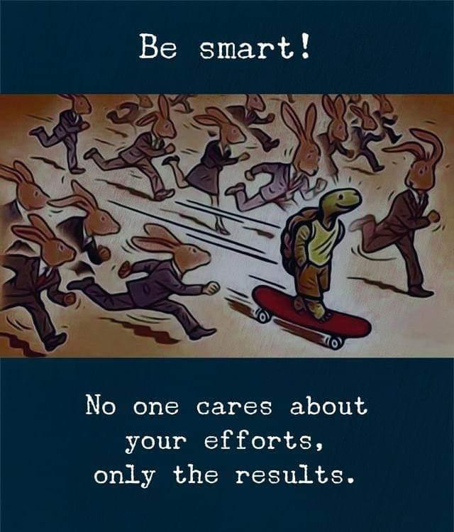

Slide 22
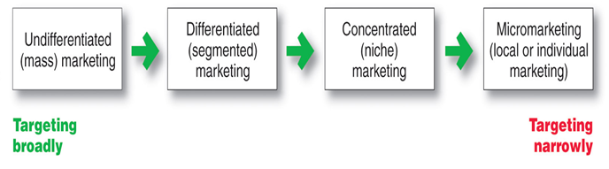
Target Marketing Strategies

Slide 23
Market Coverage Strategies
Company
Marketing Mix
Market
Undifferentiated Marketing
targets the whole market with one offer.
mass marketing
Focuses on common needs rather than what’s different.
Notes:
Market Coverage Strategies
This CTR corresponds to Figure 7-4 on p. 217 and relates to the discussion on pp. 216-219.
Market Coverage Strategies
Undifferentiated Marketing. This strategy uses the same marketing mix for the entire market. This strategy focuses on the common needs of the market rather than differences in it. Undifferentiated marketing provides economies of scale on product costs but may be limited in application.
Differentiated Marketing. This strategy targets several market segments and designs separate marketing mixes for each of them. Product and marketing variation also helps company image and may produce loyalty in consumers as they change segments.
Concentrated Marketing. This strategy commits a company to pursue a large share of one or more submarkets. Economies and segment knowledge and service are strengths of this approach but risk due to smaller market size is greater.

Slide 24
Company
Marketing Mix 1
Segment 1
Company
Marketing Mix 2
Segment 2
Company
Marketing Mix 3
Segment 3
Differentiated Marketing
targets several different market segments and designs separate offers for each.
Goal is to achieve higher sales and stronger position.

Slide 25
Segment 1
Company
Marketing
Mix
Segment 2
Segment 3
Concentrated Marketing
targets a large share of one or few smaller segments or niches
Limited company resources
Knowledge of the market
More effective and efficient

Slide 26
Company
Marketing
Mix
Individual
Customer
Custom Marketing Strategy or Micromarketing Strategy
the practice of tailoring products and marketing programs to suit the tastes of specific individuals and locations.
Local marketing
Individual marketing

Slide 27
Local marketing involves tailoring brands and promotion to the needs and wants of local customer groups
Cities
Neighborhoods
Stores

Slide 28
Individual marketing involves tailoring products and marketing programs to the needs and preferences of individual customers
Also known as:
One-to-one marketing
Mass customization
Markets-of-one marketing

Slide 29
Positioning for Competitive Advantage
Product’s Position - the place the product occupies in consumers’ minds relative to competing products.
Marketers must:
Plan positions to give products the greatest advantage
Develop marketing mixes to create planned positions

Slide 30
Differentiation and Positioning
Choosing the Right Competitive Advantage
Difference to promote should be:
Important
(difference delivers a highly valued benefit to target buyers)
Distinctive
(competitors do not offer the difference or the company can offer it in a more distinctive way)
Superior
(difference is superior to other ways that customers might obtain the same benefit)
Communicable
(difference is communicable and visible to buyers)
Preemptive
(competitors can not easily copy the difference)
Affordable
(buyers can afford to pay the difference)
Profitable
(the company can introduce the difference profitably)

Slide 31
Choosing and Implementing a Positioning Strategy
Step 1. Identifying a set of possible competitive advantages: Competitive Differentiation.
Step 2. Selecting the right competitive advantage.
Step 3. Effectively communicating and delivering the chosen position to the market.

Slide 32
Differentiation and Positioning
Choosing a Differentiation and Positioning Strategy
Identifying a set of possible competitive advantages to build a position by providing superior value from:
Product differentiation
Service differentiation
Channel differentiation
People differentiation
Image differentiation

Slide 33
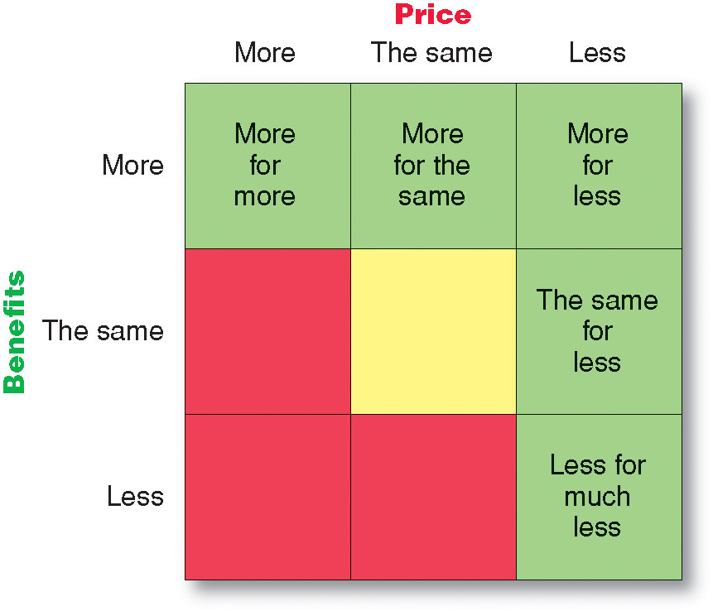
Differentiation and Positioning
Selecting an Overall Positioning Strategy
Value proposition is the full positioning of a brand -the full mix of benefits upon which a brand is positioned

Slide 34


Slide 35
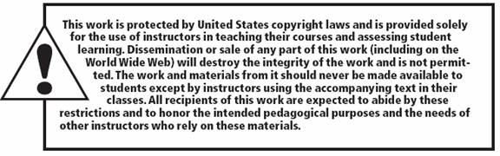
All rights reserved. No part of this publication may be reproduced, stored in a retrieval system, or transmitted, in any form or by any means, electronic, mechanical, photocopying, recording, or otherwise, without the prior written permission of the publisher. Printed in the United States of America.
Copyright © 2010 Pearson Education, Inc.
Publishing as Prentice Hall

